Slide 1


Thursday 19th September 2024
Parent Phonics Workshop

Slide 2


Parent Phonics Workshop

Slide 3
At Lime Wood Primary School, we value reading as an essential life skill that empowers children to reach their full potential.
We have high expectations of our children as readers and our aims are:
• to teach every child to become a fluent and confident reader
• to give children the reading skills necessary to enable their learning in all subjects
• that each child grows to enjoy reading, in order that they become lifelong readers

Slide 4
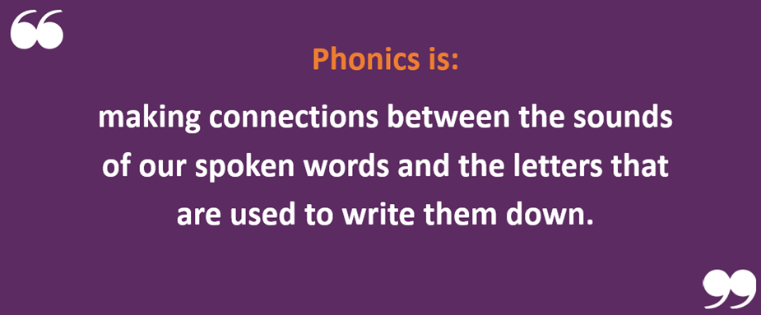
Parent Phonics Workshop
Phonics is a way of teaching children how to read and write.
It helps children hear, identify and use different sounds that distinguish one word from another in the English language
Did you know…?
The English language has:
26 letters
44 sounds
Over 100 different ways to spell those sounds

Slide 5
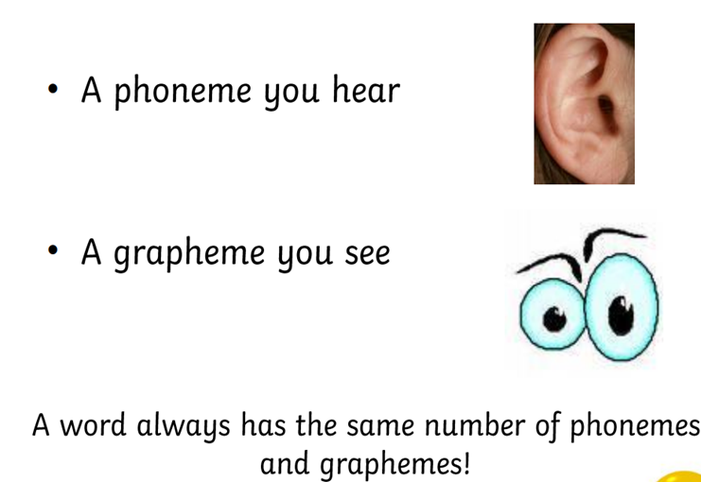
Parent Phonics Workshop
Terminology
Phoneme – Any one of the 44 sounds which make up words in the English language.
Grapheme – How a phoneme is written down. There can be more than one way to spell a phoneme. E.g.
the phoneme ‘ai’ is spelt differently in
each of the words ‘way’, ‘make’, ‘fail’, ‘great’,
‘sleigh’ and ‘lady’.
Segmenting – Identifying the individual
sounds in a spoken word e.g. ‘d-o-g’.
Blending – Putting the sounds together in a word to
read it, e.g. ‘d-o-g’ blended is ‘dog’.

Slide 6
Parent Phonics Workshop
GPC- Grapheme Phoneme Correspondence. Knowing a GPC means being able to match a phoneme to a grapheme and vice versa.
Digraph – 2 letters making one sound. (sh, ai, ee) A consonant digraph contains two consonants e.g. sh ck th ll. A vowel digraph contains at least one vowel e.g. ai ee ar oy.
Trigraph – 3 letters making one sound. (ear, air, igh)
Split digraph – This is taught in year one. A digraph representing a vowel sound where the two letters making the sound are not adjacent e.g. ‘a_e’ in ‘take’.
a-e (make)
e-e (these)
i-e (like)
o-e (home)
u-e (huge)

Slide 7

Parent Phonics Workshop
Tricky words-
The national curriculum refers to these as ‘common exception words’ (sometimes referred to as ‘tricky words’), because they contain GPCs that are unusual or GPCs that haven’t been taught. Children are taught to read and spell these by noting the part that is an exception to what they have been taught so far. We refer to this as the ‘tricky bit’. For example, in the word ‘said’, ‘s’ and ‘d’ correspond to the phonemes /s/ and /d/ as usual, but ‘ai’ corresponds to the phoneme /e/, which is unusual.

Slide 8
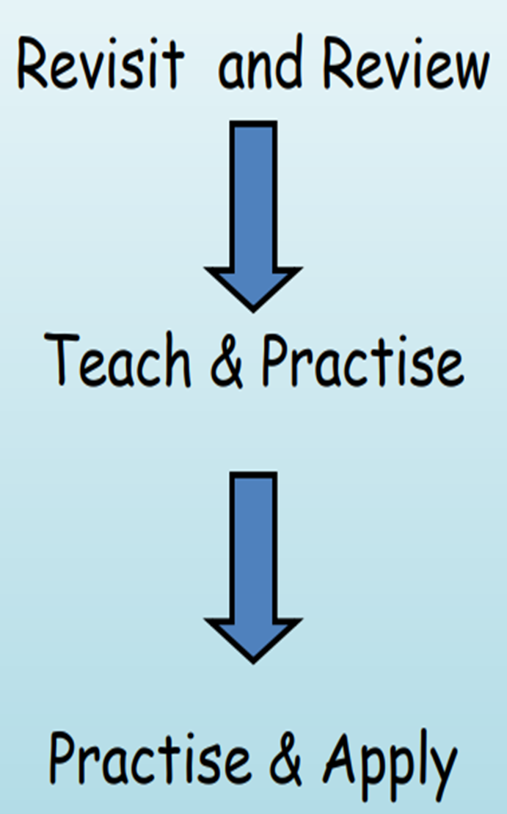

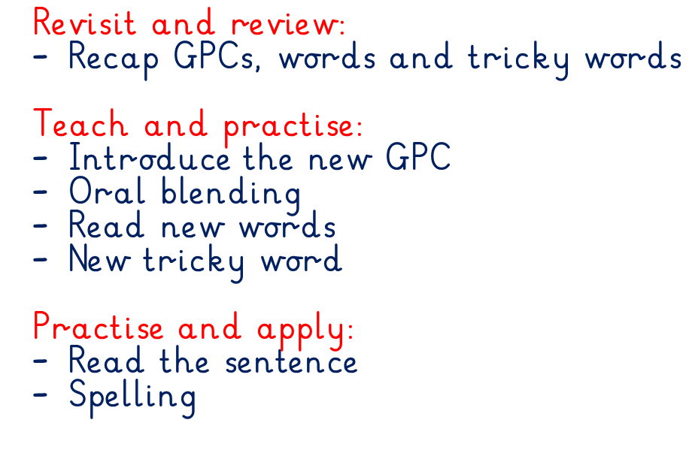

Parent Phonics Workshop

Slide 9
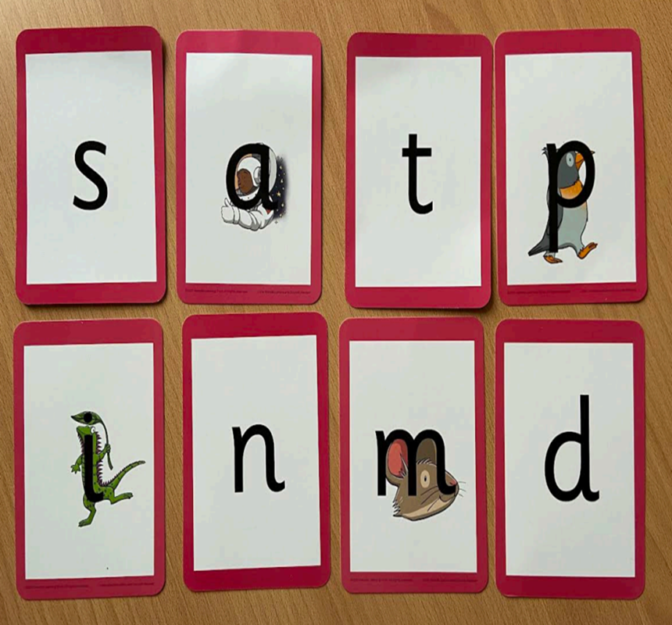
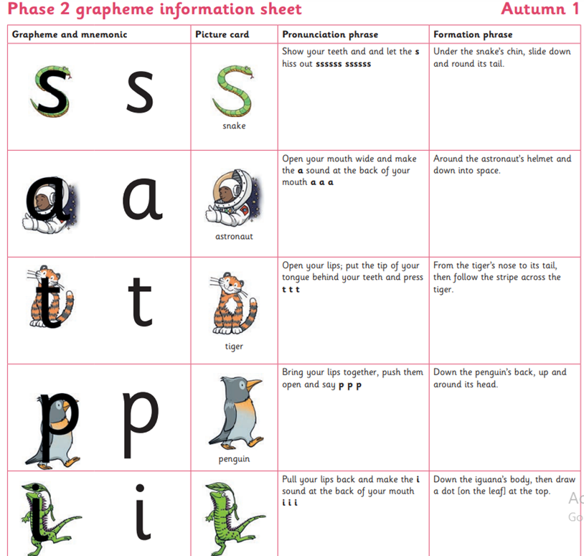
Parent Phonics Workshop
Resources
Feel free to look at the resources set out on the table

Slide 10
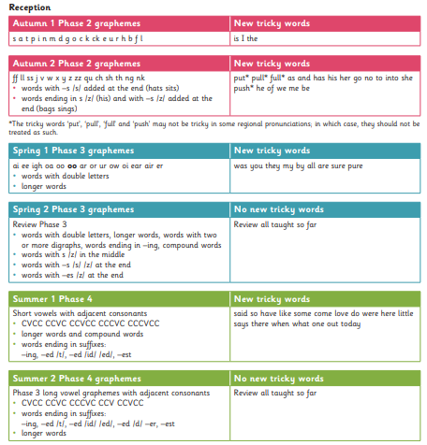
Parent Phonics Workshop
Progression of phonics teaching in Reception.
You can view this on our website.

Slide 11






Parent Phonics Workshop
Children begin with wordless books. These are the foundation to understanding books, developing great language skills and teach children the layout of books and how to handle books. Can your child tell you what is going on in the book using full clear sentences?
Once children have secure knowledge of a number of GPC’s (Grapheme Phoneme Correspondences) and are confidently blending, they will be ready to read books. Books correspond to the letters and sounds children have learnt in class.

Slide 12
Parent Phonics Workshop
How we teach reading
Reading practice sessions are timetabled each week with a member of the EYFS team working with one small group at a time.
Reading practice books are carefully matched so children can read fluently and independently.
The reading sessions cover:
Decoding.
Prosody (intonation, expression)
Comprehension.
When children take their book home to read they should be 95% fluent. Please do not worry that a book is too easy – your child needs to develop fluency and confidence in reading. Re-reading a book they have had before helps develop fluency – this is the goal. Celebrate their success ☺

Slide 13

Parent Phonics Workshop
Reading at home…
Before reading…
- Have your child look at the cover and predict what
they think the story is going to be about
- Point out the name of the book (title), the person who wrote the book (author) and the person who drew the pictures for the book (illustrator)
- Do a picture walk through the book and let your child tell you what they think the book is about
- Don’t look at the last page of the book, predict how the story might end

Slide 14
Parent Phonics Workshop
Reading at home…
During reading…
Ask your child questions about the characters in the book as you read the story
Have your child use their ‘phonic’ finger to follow the direction of the text (left to right, top to bottom)
Encourage your child to look at the sentences and see if they can identify any of the sounds in the words or any of the tricky words they have covered in class

Slide 15
Parent Phonics Workshop
Reading at home…
After reading…
Discuss with your child what they liked/disliked about the story and why
Can your child think of another title for the book and explain it?
Did the story have a sad or happy ending?
Can your child think of a different ending for the story?
Can they summarise what happened at the beginning, in the middle and at the end?
Can they recall key events from the story and find them in the book?

Slide 16
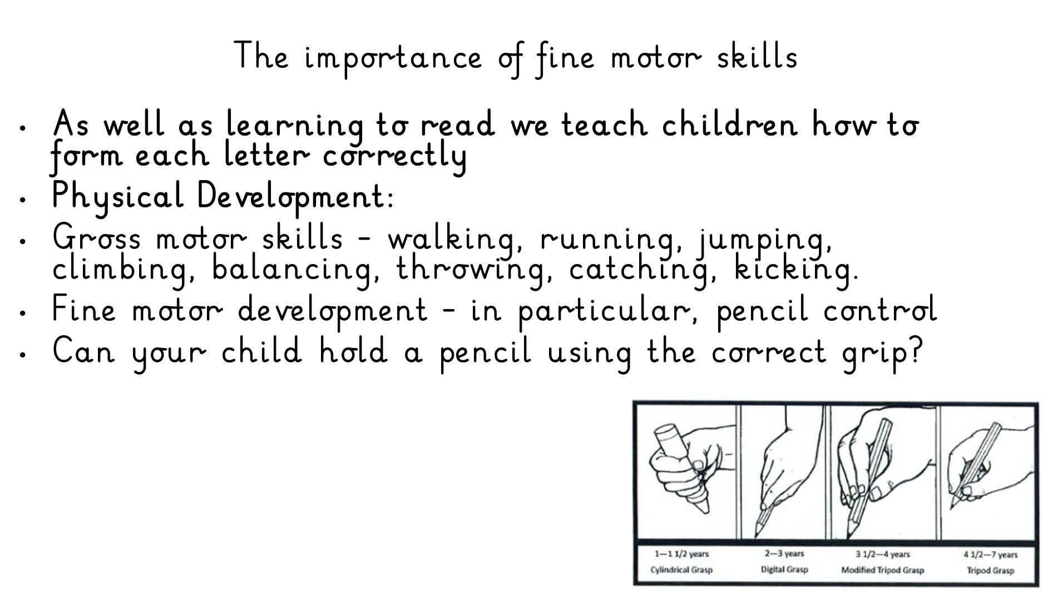
Parent Phonics Workshop

Slide 17
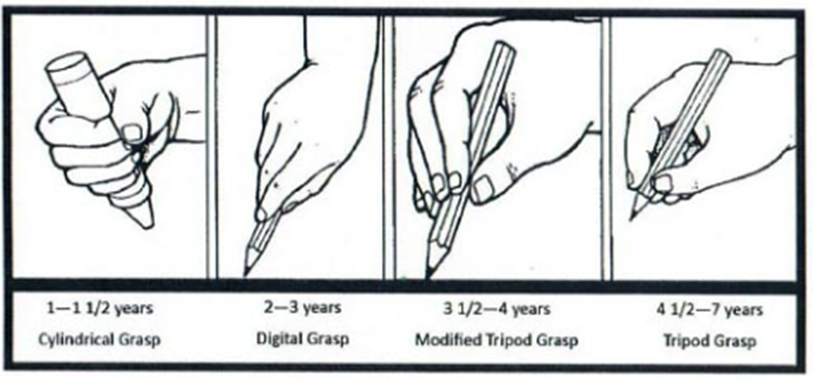
Parent Phonics Workshop
Handwriting begins with good pencil grip and the child’s name
Building the muscles in the wrists and hands through: pinching/ squeezing/ pushing/ pincer grip/ poking/ squishing/ rolling/ rolling/ digging
Activities to support fine motor skills – playdough, threading, drawing, painting, colouring, weaving, lacing, using cutlery

Slide 18
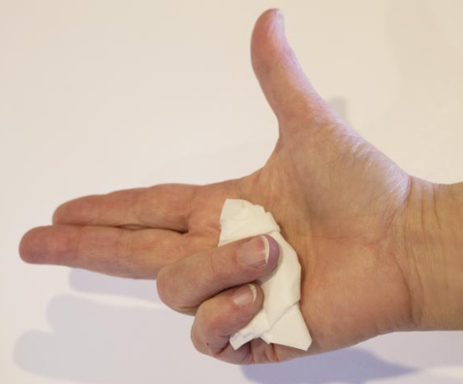
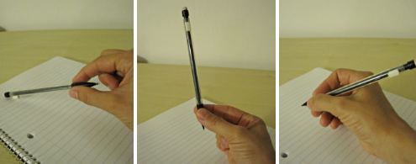
Parent Phonics Workshop
Useful Tips for Teaching Efficient Pencil Grip
Hold a ball of tissue or a small soft foam ball with 2 fingers.
Short triangular pencils.
Pinch and flick.

Slide 19
Parent Phonics Workshop
What can you do to support your child?
- Go to the Little Wandle website to access videos and guidance for parents.
Share books with your children for pleasure.
Check on our website for documents to support reading and phonics.
Encourage your child to use their phonic knowledge and blending skills daily.
Help them spot tricky words when out and about.
Reread books to develop fluency
Provide lots of encouragement and praise
Play the fool- they can be your teacher!
Play ‘I Spy’ with letter names and sounds
Write tricky words on flashcards and stick them around the house. How many can they read in a set amount of time?

Slide 20
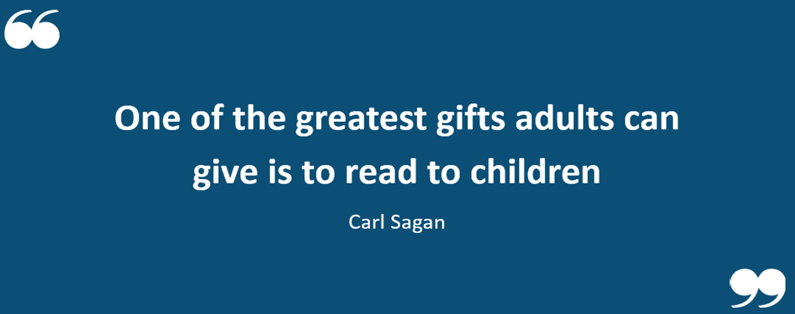
Parent Phonics Workshop
Thank you for listening.
Any questions?

