Slide 2
What is the
Children’s University?
By the time a child turns 18, they will have spent just 9% of their waking life in a classroom.
Children’s University is about making the most of the remaining 91%!
We reward children and young people aged 5-14 (primary and secondary aged children and young people) for taking part in Learning Outside the Classroom and extra-curricular activities.

Slide 3
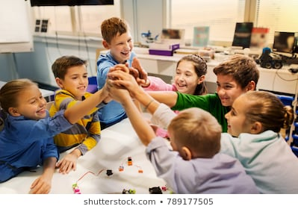
How does the Children’s University develop skills?
For every child that takes part in Children’s University, we want the following outcomes:
They feel they have grown in confidence and self-belief
They have enjoyed new experiences, in new places and want to keep exploring
They believe they have a broader range of essential skills
They feel empowered to make positive choices about their future
They see learning that is fun, aspirational and lifelong
They feel their eyes have been opened to a multiplicity of learning activities and opportunities
They feel celebrated for their commitment to learning by their family, school and community.

Slide 4
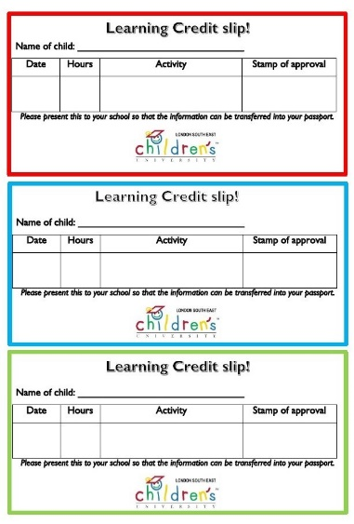
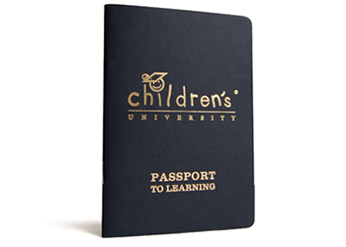
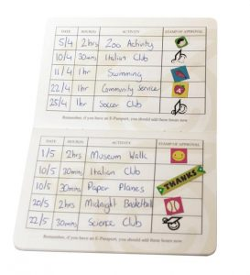
How does it work?
Everyone who is signed up to Children’s University will get their own Passport to Learning and access to their personal Children’s University Online account. This is where your child will be able to see the stamps they have collected at all the different clubs and activities they go to.
Simply take their passport with you to a validated Learning Destination or activity to earn a Children’s University stamp and CU Online code!

Slide 5
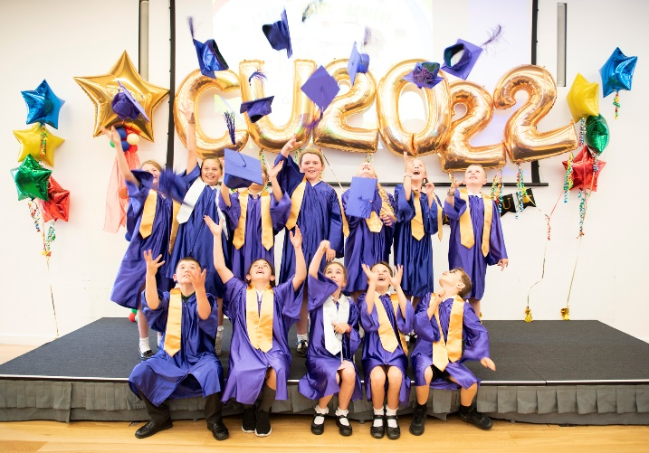
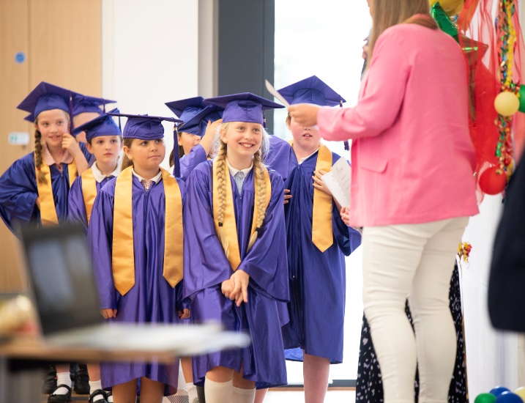
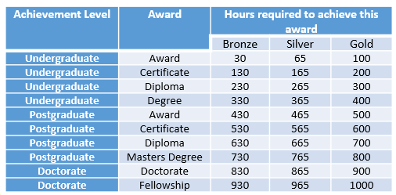
What happens next?
Every time your child collects a stamp, they get closer to being able to come to a special celebration of your achievements!
This is called a “Graduation”
We hold a graduation each year, usually at the beginning of July, and your child can graduate at lots of different levels, all the way from 30hrs up to 1000hrs!

Slide 6
Ways in which your child can earn stamps for their passports…
There are a number of ways your children can earn stamps for their passports… let’s have a look…

Slide 7
Attending after-school or lunchtime clubs in school
If your child attends a Children’s University school, then all the lunchtime and after-school clubs, as well as educational visits will count towards their Children’s University passport!
These are added by teachers at the end of each half term!

Slide 8
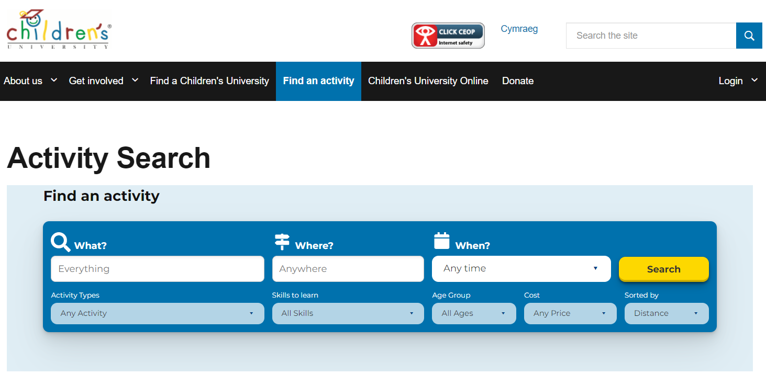
Attending activities or clubs with Learning Destinations (local, national or online ones!)
Our directories showing ALL of these Learning Destinations
are on our Google Drive and you can also search the Children’s University website:

Slide 9
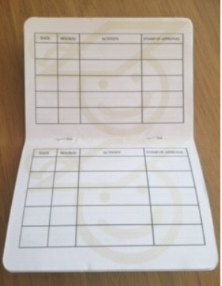
Take your CU passport with you and ask the club to stamp the passport – they should also provide you with a stamp code (a colour and 4 numbers, for example, “Purple 4321”).
If they aren’t sure what the code is,
please email me and I can provide it.
Also, if you forget your passport, it is not a problem – simply get the code and just ensure you log this on your child’s Children’s University Online account!

Slide 10
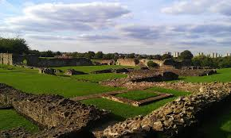
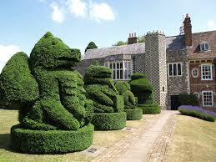
Some of our Learning Destinations

Slide 11
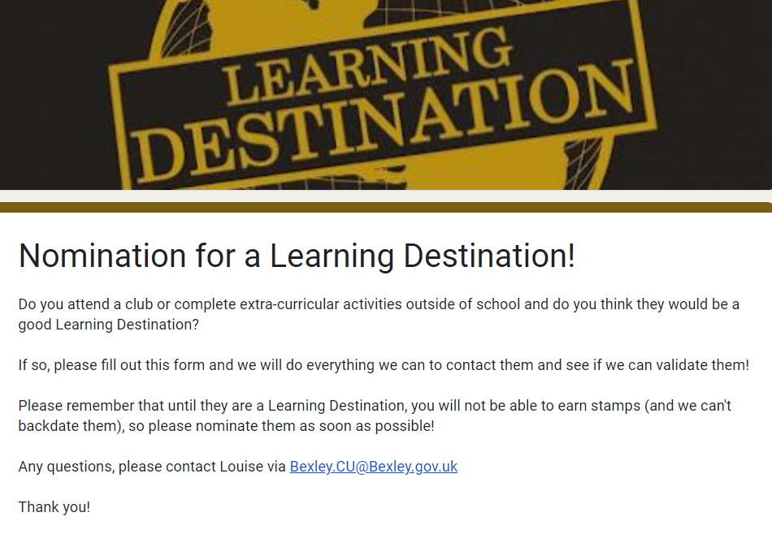
If your child attends a club that isn’t on our list of Learning Destinations, please nominate them so I can contact them to see if they would like to become one. Until they are a Learning Destination, it is not possible to earn stamps with them.
The nomination form is on the Google Drive and via this link: https://forms.gle/LkMshaiH89ujCPhK8

Slide 12
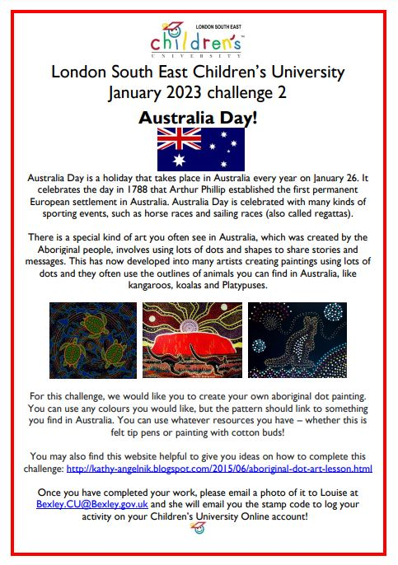
Completing CU Challenges and activities
I share new challenges at least twice a month. They are often linked to special days or events and there is also a back catalogue of over 50 challenges.
They can all be found on our Google Drive: https://drive.google.com/drive/folders/10nKJtRYH2TgJkGn2Deqe_Dt5U2tff_m2?usp=sharing
Once competed, simply email a photo of the work to Louise and she will send you the stamp code.

Slide 13
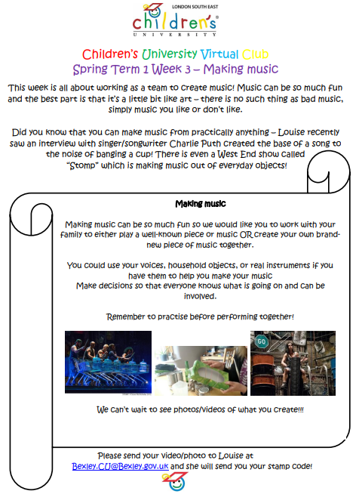
LSE CU Virtual Club
We have also launched a Virtual Club, which you can join for FREE!
Each half term there is a new theme and every week a new activity is shared (via email, term time only) that will earn your child stamps for your passport.
You can choose when is the best time that week to complete the activity.
You will need to sign your child up to this via a Google Form, which is on our Google Drive or via this link: https://forms.gle/uYC8JN27abvKqbfD7 !

Slide 14
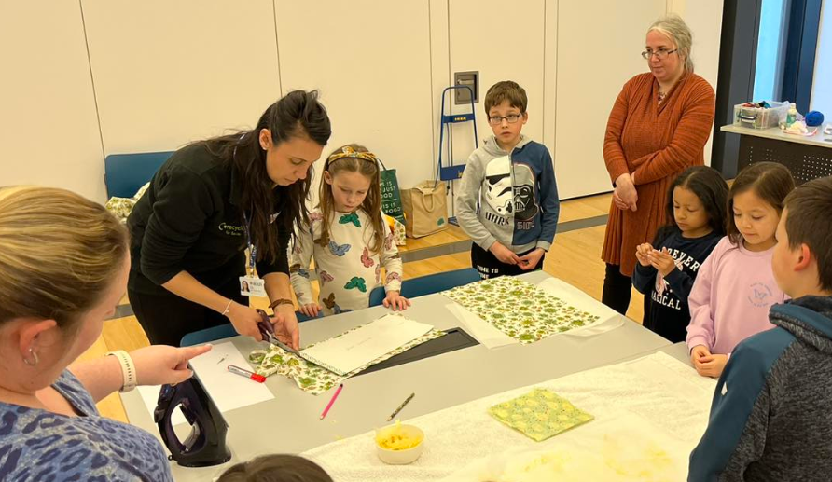
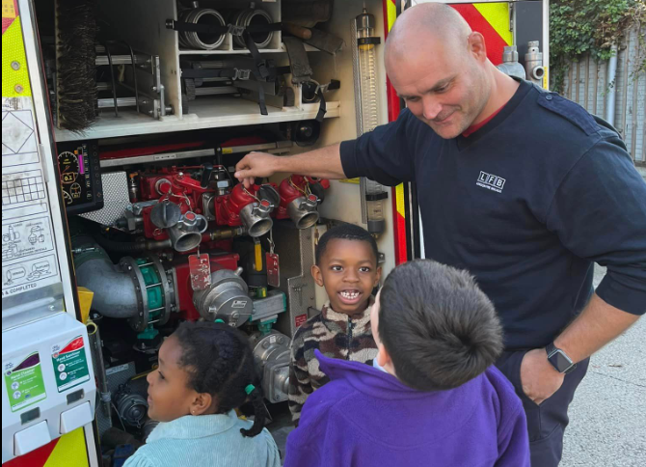
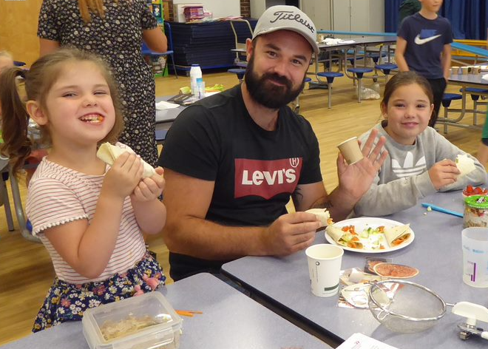
One-off events and workshops
We are increasingly able to offer workshops and events where children can earn stamps for their passports.
Events include Family Cookery Workshops, Eco-workshops, Fire Fighting Workshops, Kindness Workshops and taster sessions.
Keep an eye out on social media (although please be aware, they are exclusively for CU pupils!)

Slide 15
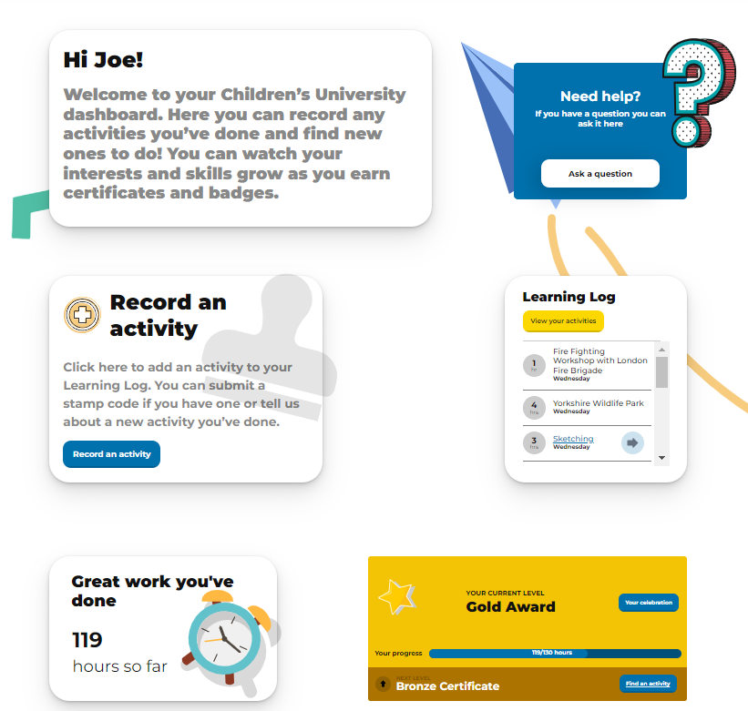
Children’s University Online
When your child earn stamps for their passport, they will need to get their passport “stamped” by the Learning Destination.
They will also receive a code, which they can use to log their hours on their CU Online account. This code is a colour followed by 4 numbers, for example, “Yellow 2580”
Your child has been given a username and password which they can use to log onto their account via https://www.childrensuniversity.co.uk/
Louise will train children in Years 3+ on how to use this system, but at the end of this presentation there are also slides showing you how to use it. This guide can also be found on our Google Drive via this link: https://drive.google.com/file/d/1cz2ovZaHvAziQQ7aFN2b7WsRWoavofOt/view?usp=drive_link

Slide 16
The process!
Take part in a validated activity
Get your passport stamped with the CU Online code
Log the hours on CU Online, using the code provided!

Slide 17
Where can I find information
and help with Children's University?
All of the information you need is on our recently updated website https://www.lsec.ac.uk/cuhome and our Google Drive which can be accessed via this link: https://drive.google.com/drive/folders/10nKJtRYH2TgJkGn2Deqe_Dt5U2tff_m2?usp=drive_link

Slide 18
How can I sign my child up?
This will depend on the school, so please contact your child’s school in the first instance.
If you are unsure if your child’s school is part of Children’s University, you are welcome to contact Louise via Bexley.CU@Bexley.gov.uk
Alternatively, if your child’s school is not a part of London South East Children’s University, you can join a nationwide online subscription with the Children’s University Trust. It is a slightly different offer than what we offer to our schools but is a great way to link with Children’s University if their school is not in a position to do so!
You can find out more on the Children’s University website via this link: https://www.childrensuniversity.co.uk/childrens-university-online/

Slide 19
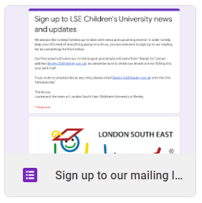
How can I keep up to date?
One of the best ways you can get involved and keep up-to-date is by signing up to our Mailing List and following us on social media.
By signing up to the Mailing List, you will be sent the challenges directly each month as well as being the first to find out about special events and news!
You can do this via a short Google Form on our Google Drive.

Slide 20
FAQs
What happens if my child completes an activity but doesn’t have a passport with them?
If your doesn’t have their passport, they can ask the Learning Destination to fill out a Learning Credit Slip, which can be attached to their passport.
These have been emailed out to all Learning Destinations are also available on the Google Drive: https://drive.google.com/file/d/179CiSpKaCmKNYj-tQgS4fEzz4hdN0qE7/view?usp=sharing
Do I have to pay all the activities for my child to get stamps?
We are always looking for ways in which your child can earn stamps at low or no-cost. Activities such as our challenges and the Virtual Club activities do not cost anything but if you attend sessions at our Learning Destinations, then you will pay in the same way that you would if your child wasn’t a part of Children’s University.
Do I have to pay for my child to attend the graduation?
Nope! The graduation is free to attend!

Slide 21
FAQs
Can my child earn stamps doing activities or clubs that aren’t Learning Destinations??
Unfortunately not, as there is a validation process that we go through with all Learning Destinations to ensure they meet our requirements and . There is a “Nomination for a new Learning Destination form” on the Google Drive which enables pupils to ask their clubs to fill it in and get in contact with me, but please don’t stamp the passport if it has not been validated as this is an important part of our safeguarding policy and process.
Can I backdate stamps for activities earned prior to joining CU?
No, unfortunately we cannot backdate stamps for activities earned prior to joining CU. The only exception is for the summer holidays where activities such as the Summer Reading Challenge or CU camps.
Who can I contact if I need help?
Your first contact will be your school’s Children’s University lead, but I am always happy to answer any questions!
The best way to stay up-to-date is to sign up to our Mailing List and to follow us on social media! You can do this on our Google Drive!

Slide 22
Here are details of how to use Children’s University Online…

Slide 23
A guide to using Children’s University Online (CU Online)
CU Online is a fantastic system that allows you to track your progress with Children’s University and see which categories and skills you are developing by logging your hours!
Whenever you take part in a validated activity at a Learning Destination, you will need to get your passport stamped (as normal) but you will also be given a code, consisting of a colour and four numbers, for example, “Red 4321”.
You can then log onto your CU Online account and log your hours.
At the end of each academic year, we will use CU Online to see who is eligible to graduate! It is important that all hours have been logged by the time the report is created via CU Online, so please remember to log their hours as soon as possible!

Slide 24
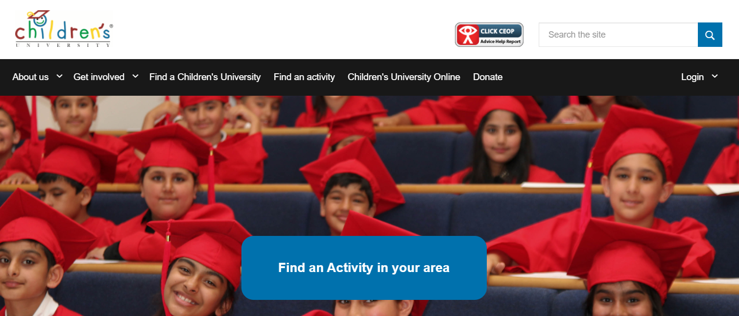
How to log on
Go to https://www.childrensuniversity.co.uk and click “login” then “login as child” from the drop-down menu.
If you search via Google, please do not click on the “login” option as the link doesn’t work and we can’t seem to have it taken down! The best way is to go via the Children’s University website, as shown above.
Please also check that you are logging in as a child, not a parent or teacher as your child’s login details won’t work if you try logging in with them.

Slide 25
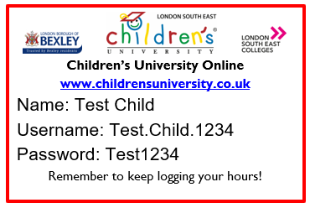
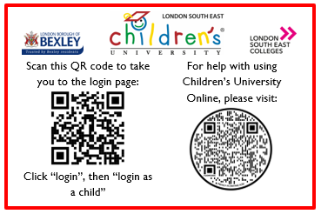
Logging on
Your child will be given their login card from their school. If you lose this, please contact them the school to re-issue as Louise from Children’s University is unable to do this.
Please login using the details on your login card. It is very case sensitive, so please copy it EXACTLY as it is on the card. You can also scan the QR code on the back to quickly access the logging in page!

Slide 26
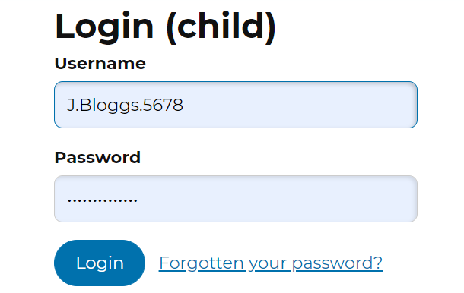
Logging on
Please login using the details on your login card. It is very case sensitive, so please copy it EXACTLY as it is on the card.
If you have forgotten your password, you can click the “Forgotten your password” button.
If you want to change your password in the future, that is no problem – just make sure your new password has at least 8 characters, including a capital letter and a number.

Slide 27
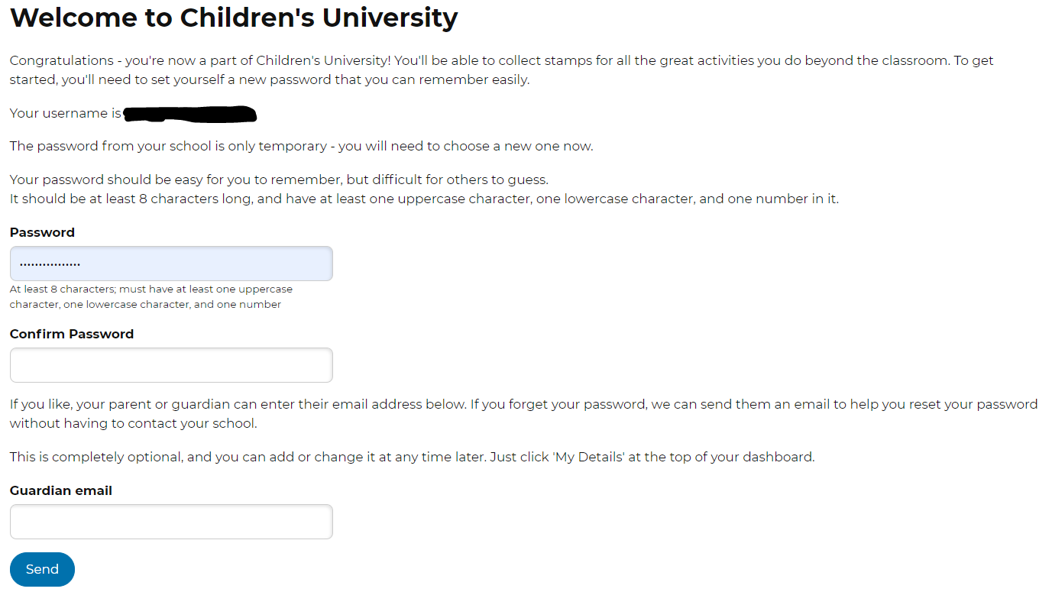
Logging on
The very first time you log on, you will need to re-enter your password (don’t worry – you only need to do this once):
1. You will need to re-type in the password on your login card.
Please make sure it matches or it won’t work!
2. You don’t need to add an email now – you can add this later.
3. Now click “send”

Slide 28
Your CU Dashboard
You will then see your CU Dashboard.
This holds all the information about your stamps, current graduation level and much more!

Slide 29
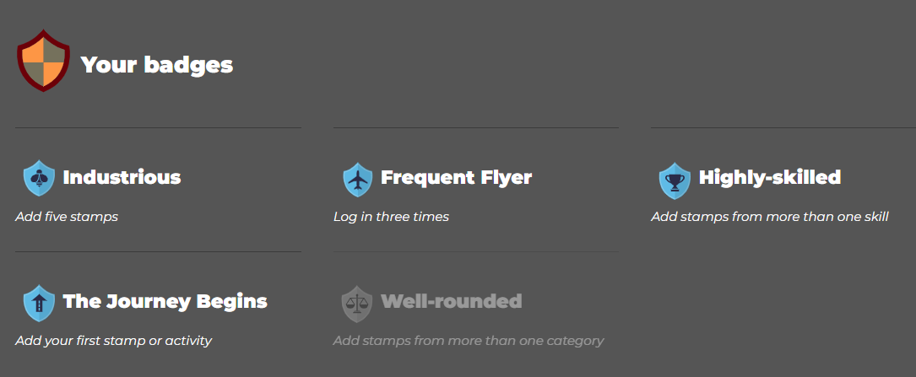
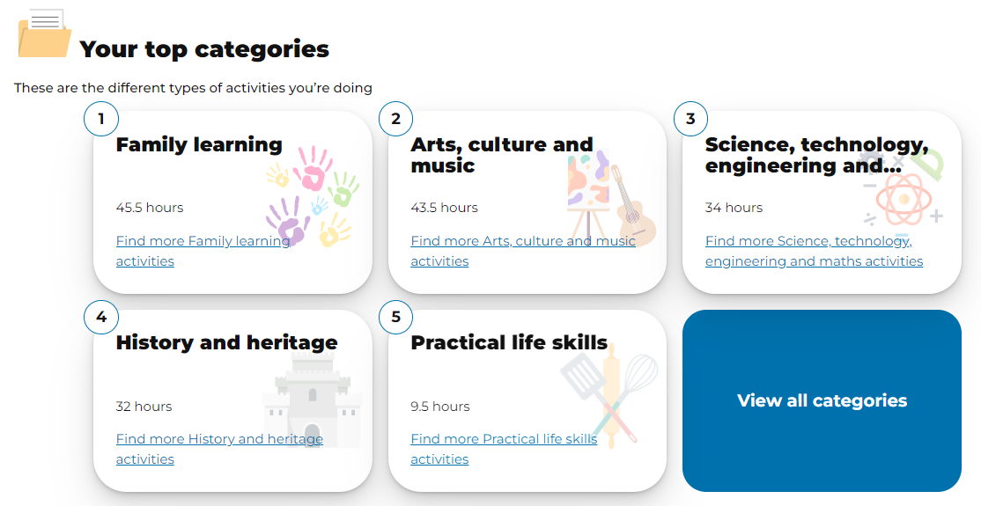
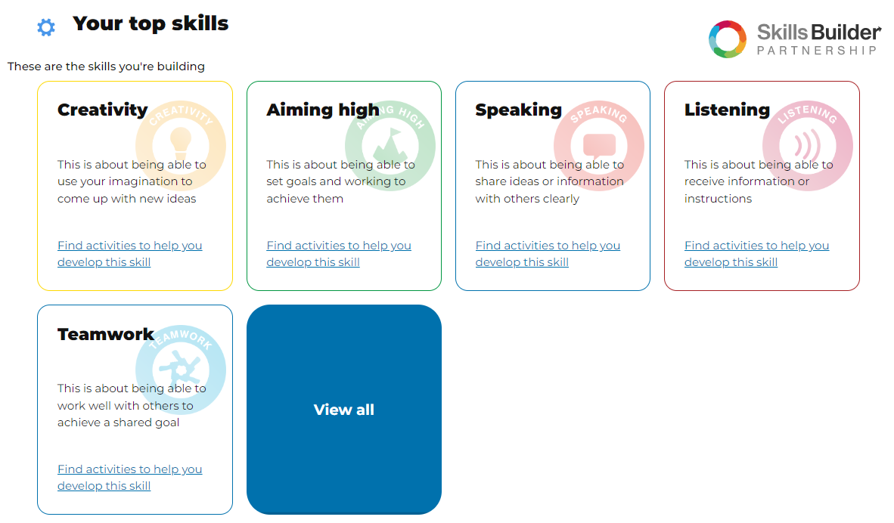
Your CU Dashboard
If you scroll down your dashboard, you will also see the badges you have earned (not linked to graduation levels) as well as the categories and skills you have been developing by doing activities!
You can also see the activities and clubs taking place at your school – these are exclusive to your school and you won’t find them if you search for activities.

Slide 30
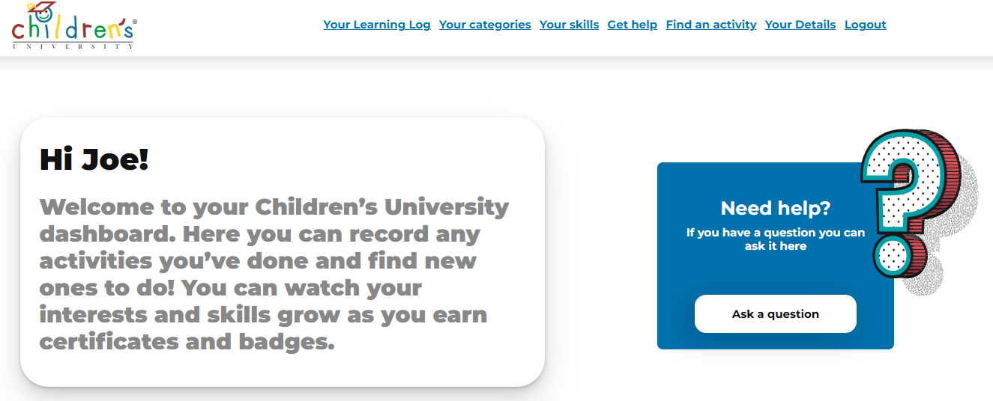
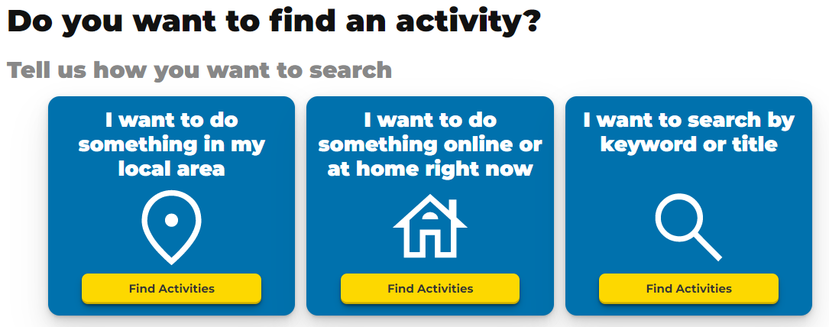
Your CU Dashboard
You can also search for activities, which now includes activities you can do online as well as activities local to where you live.
Simply click “Find an activity” on the top of the screen and it will give you options to search for activities you would be interested in!

Slide 31
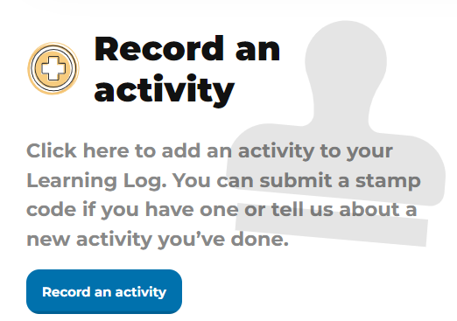
Adding activities to your online passport
There are 3 different ways of logging activities you have done...
1. You attend a Learning Destination or complete a challenge and are given a stamp code that you need to log.
2. You complete an activity that won’t earn you stamps for your passport, but you would like to have a record of it.
3. You complete an activity and would like a stamp for it.
Let me show you how…

Slide 32
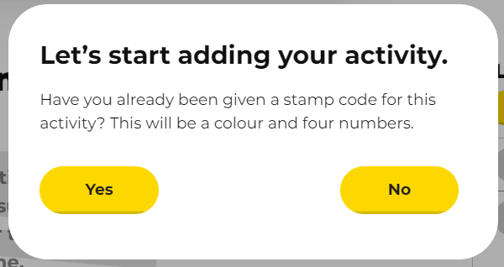
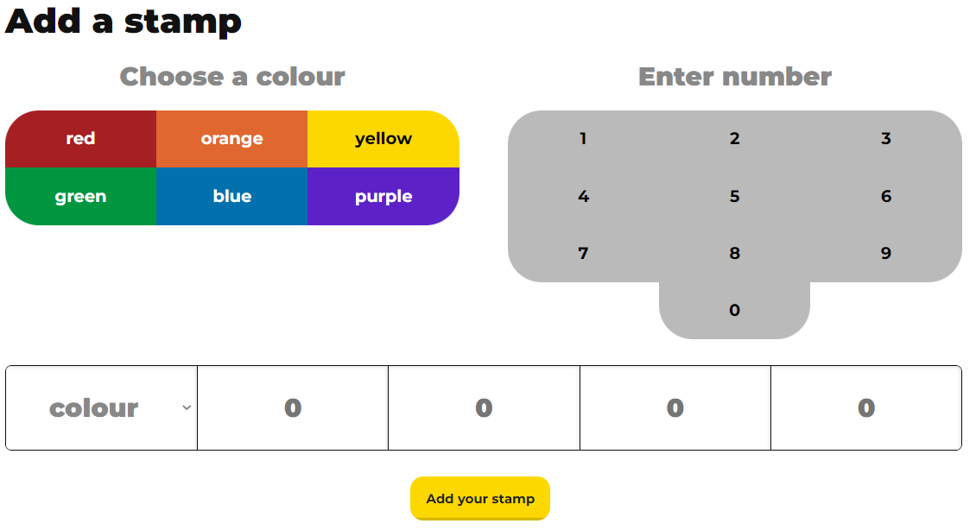
1. Adding a stamp code you have been given
To log a code you have been given, click on “record an activity”, then “yes” on the pop up and this will take you to the page where you can add the stamp by clicking on the colour, followed by the number.
The code will always be a colour followed for four numbers,
For example “Red 4321”.
Then click “Add your stamp”.
When inputting the numbers, please make sure that it is one number per box or it won’t work!

Slide 33
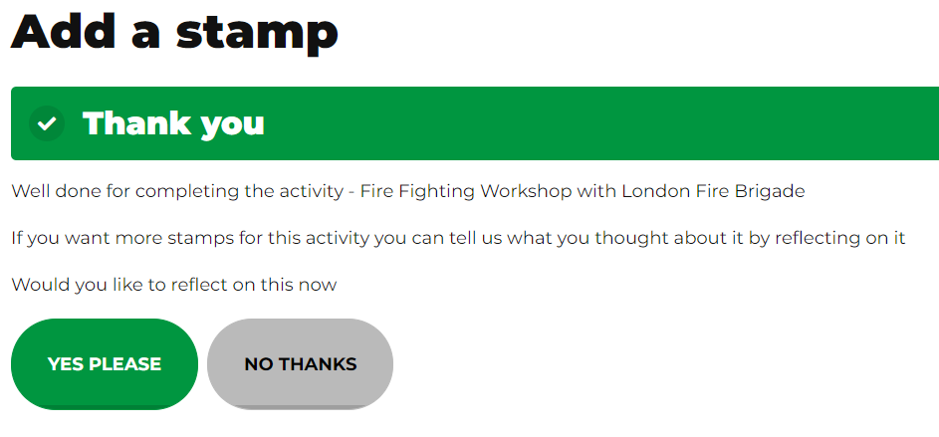
Reflecting on an activity
If you are inputting a stamp code, you can also reflect on the activities you have taken part in. You will see this screen once you have input the stamp code and simply click “yes please” if you would like to reflect on it:
For every 2 activities you reflect on, you will receive another 30min stamp!

Slide 34
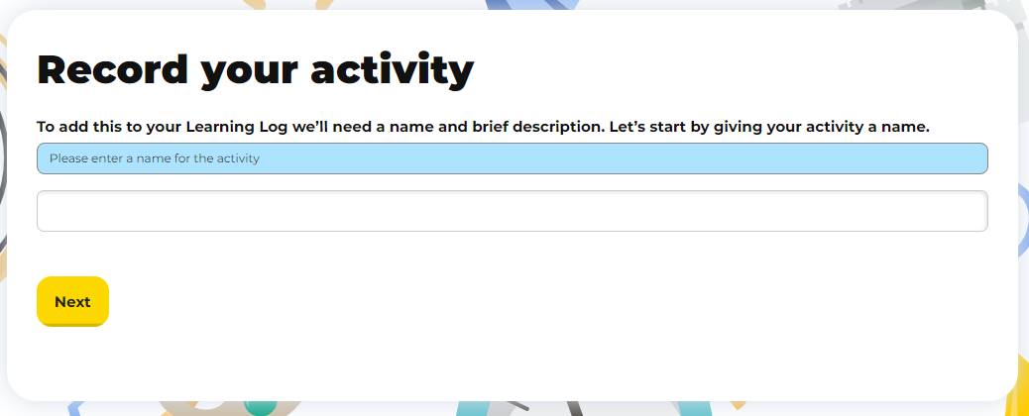
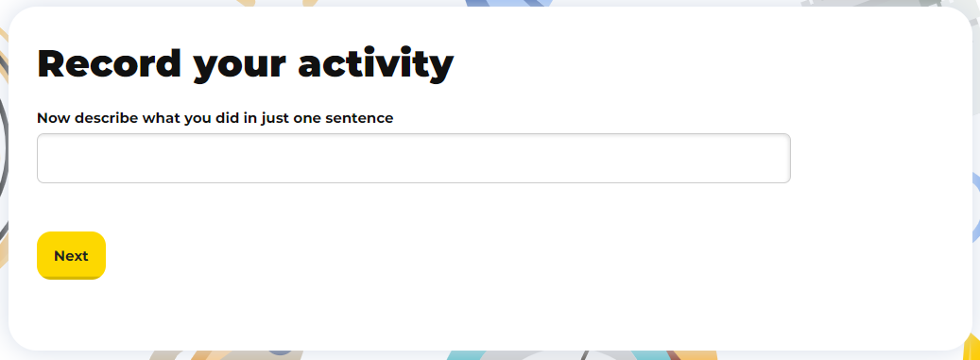
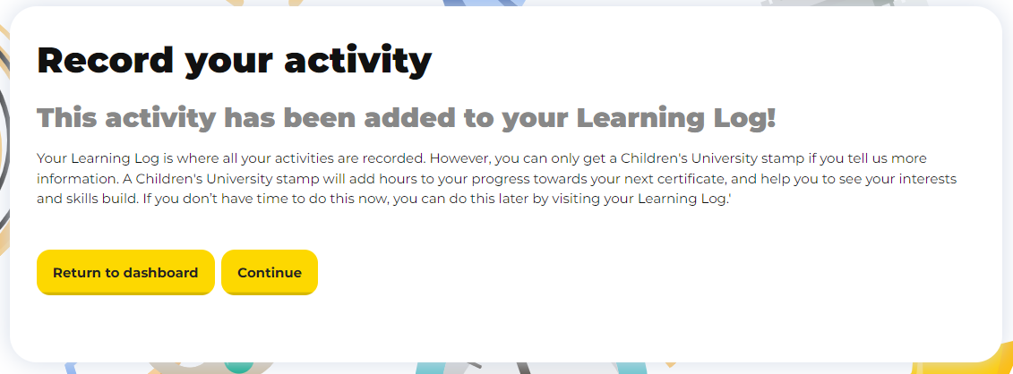
2. Adding an activity for your records (but won’t earn you stamps)
To log an activity you have done that won’t give you stamps towards your passport, but will be a record of what you do…
Click on “Record an activity” and then “no” when the screen pops up.
You can then give your activity a title and a sentence about what the activity involved.
You will then see that the activity has been added to your Learning Log.

Slide 35
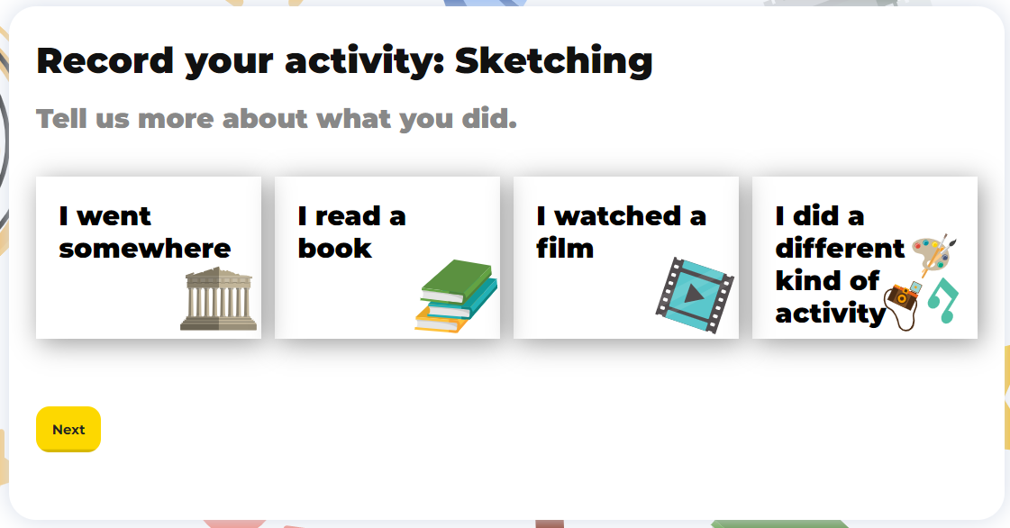
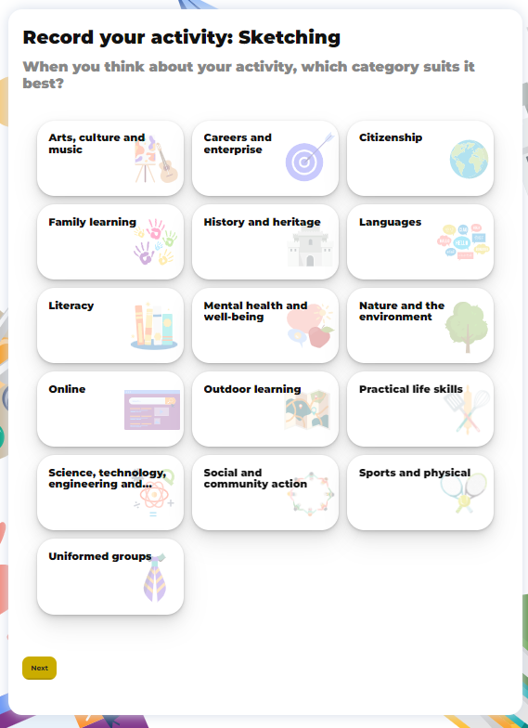
3. Adding an activity to get a stamp
To log an activity you have done and you would like a stamp for it, follow the instructions for recording an activity on the previous page but when you get to the final screen, click “continue”.
It will then ask you questions about what you did, what categories and skills you think it involved and you will need to give more details about the activity. I couldn’t fit all the screens on this page, but it will take you through a few questions.
You will need to give some detail about what you did – it won’t let you write just a couple of words, so you may need an adult to help you write this.

Slide 36
Notes on adding stamps and activities
Adding activities this way should only be done for irregular or one-off activities. If it is being used for an activity that takes place regularly, it will need to become a Learning Destination. You can nominate a Learning Destination by completing this short Google Form: https://forms.gle/LkMshaiH89ujCPhK8
Please remember to only add activities that have a learning basis to them, as we can’t award stamps for activities that we wouldn’t be able to validate, such as going to the park, tutoring or childcare. If it doesn’t meet our extra-curricular guidelines/criteria, it will unfortunately need to be revoked.
Please only add stamp codes which you have been given for completing activities. If we notice that stamp codes are being added for activities you haven’t completed, we may need to restrict your ability to add stamp codes yourself.

Slide 37
Frequently Asked Questions
What happens if I am not given a CU Online code?
There may be times when members of staff at Learning Destinations aren’t sure of the codes, particularly when they are larger organisations with multiple members of staff.
If this is the case, please email Louise at Bexley.CU@Bexley.gov.uk with evidence of the activity and she will be able to provide you with the code.

Slide 38
Frequently Asked Questions
I attend a club that isn’t validated – can I get a stamp for this?
We are only able to provide stamps for validated Learning Destinations and activities.
You are welcome to nominate a Learning Destination by completing this very short Google Form and we will then contact the club to see if they would like to become a Learning Destination: (https://forms.gle/LkMshaiH89ujCPhK8 )
We cannot guarantee they will join us, but we will certainly contact them and ask!

Slide 39
You can now add your first stamp!
Purple 1402
This will give you a 30min stamp for learning how to use CU Online!

Slide 40
More information about
Learning Destinations
You can find lots of information about activities that are validated by London South East Children’s University by clicking on these links:
Learning Destinations in the local area https://drive.google.com/file/d/15uo61NoKnQK1CB1F7SFG4IUzQmPhWWag/view?usp=sharing
Online and at-home learning activities
https://drive.google.com/file/d/10WIuqfI9lv41-kFHQZU2DjVqdgPgm-Gy/view?usp=share_link and
https://www.childrensuniversity.co.uk/get-involved/activities-to-do-at-home-and-online/
LSE CU Challenges
https://drive.google.com/drive/folders/114EToVgf3MN3RK9iRniHXqhAm0ZSejRw?usp=sharing

Slide 41
Contact details and further information
If you have any questions or require further clarification, please do not hesitate to contact Louise on the details given below.
Louise Chalkley
Children’s University Officer, in partnership with London South East Colleges
Tel: 0203 045 5044
Email address: Louise.Chalkley@Bexley.gov.uk OR Bexley.CU@Bexley.gov.uk
Facebook: London South East Children’s University https://www.facebook.com/LSEChildrensUniversity
YouTube: London South East Children’s University https://www.youtube.com/channel/UCckjSSH0HfILmkIVWsaiEpw?view_as=subscriber
Twitter: @LSEChildrenUni https://twitter.com/LSEChildrenUni
Instagram: @LSEChildrensUniversity ttps://www.instagram.com/lsechildrensuniversity
https://www.lsec.ac.uk/cuhome
https://www.childrensuniversity.co.uk/
https://drive.google.com/drive/folders/10nKJtRYH2TgJkGn2Deqe_Dt5U2tff_m2?usp=sharing

