Slide 1
Ignite the spark, reveal the champion
Relationships & Behaviour
2025
Miss C Ingrams
Headteacher
Notes:
Welcome CI and over to AH

Slide 3
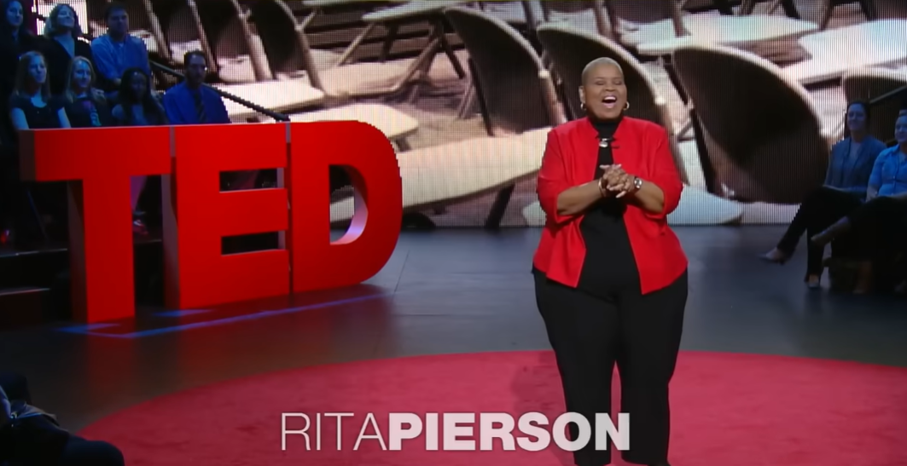
Our Why
https://youtu.be/SFnMTHhKdkw

Slide 4
Our four main principles
Routines | Recognition | Kindness & Consistency | Relationships
Scripted conversations Smart Walking Three Rules 6 legs on the floor Transitions in class | Recognition boards Positive postcards Home Contact | Restorative approaches Positive praise Recognition for all Listening Positive body language | Daily Meet & Greets Home Contact Non-confrontational
Notes:
ALL

Slide 5
Consistency
Listening, smiling
Recognising emotions
Calm, consistent, neutral
Notes:
ALL

Slide 6
We do not shout | There is never a valid reason for shouting at a child. The only exception might be if a child was in danger, for example shouting “Stop!” across a busy playground if a child was seen to be doing something which was going to put themselves or other children in harm’s way.
We always refer to the behaviour and not the child | When we are speaking to children about negative behaviour, we always talk about the behaviour so that they understand they have a choice in how they behave.
One team being responsible for all | Beyond the school gates, we encourage children to continue their positive behaviour outside of school in a number of ways. We model good behaviour when out and about in the local community.
Non-Confrontational Approach | We use a non-confrontational approach when speaking to the children and the rest of the school community. We strive to ensure that all conversations between adult and child is done privately.
Notes:
ALL

Slide 7
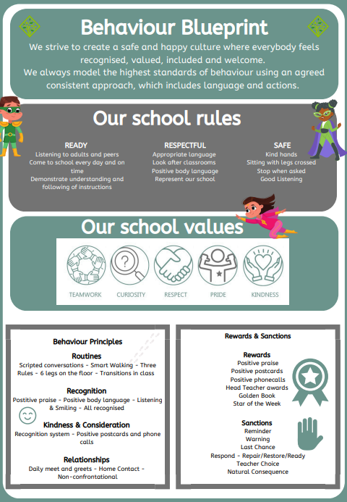
Behaviour & Relationships
It is imperative that our rules, values and principles are reinforced at all times throughout the school day.
Positive postcards
Positive phonecalls
Recognition Board/Star Jar
Meet & Greets agreements

Slide 8
Every conversation is an intervention – we coach children as a matter of course.
Notes:
ALL

Slide 9
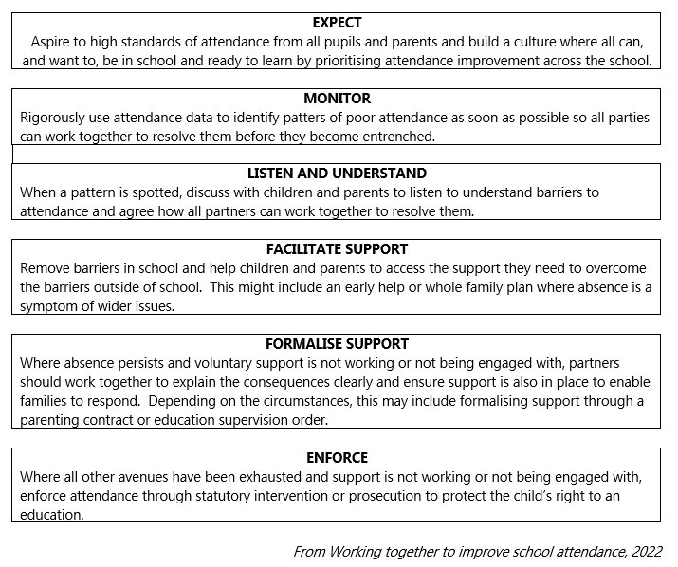
Attendance .

Slide 10
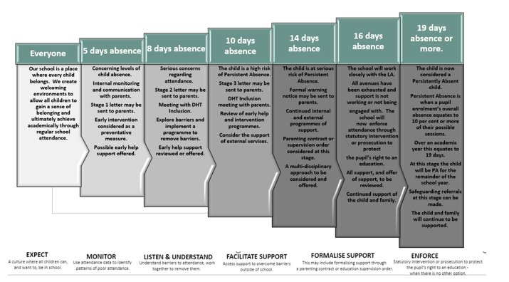
Attendance .

Slide 11
Any questions? .

